Slide 1
Psychometrics: An Introduction, Fourth Edition
Chapter 9: Estimating and Evaluating Convergent and Discriminant Validity Evidence

Slide 2
Introduction
Need to Belong Scale (NTBS): degree of interpersonal acceptance.
Association of NTBS scores with other scales and measures.
Notes:
Need to Belong Scale:
It was intended to measure the degree to which individuals desire “interpersonal acceptance and belonging.”
Although this is hypothesized as a fundamental human need, the researchers observed that people differ in the degree to which they experience this need.
In reality, some people have a relatively great need to experience frequent interactions within close and caring relationships, while others seem to need less interactions.
Association of NTBS scores with other scales and measures: If NTBS scores do indeed reflect the need to belong, then the researchers expected to find a particular pattern of associations wherein NTBS scores should be strongly positively associated with some scales, negatively associated with other scales, and not associated with yet other scales.

Slide 3
A Construct’s Nomological Network (1 of 2)
Two key questions of construct’s nomological network.
Consideration of theoretical context.
Understanding a construct’s nomological network.
Features of nomological network.
Notes:
Two key questions of construct’s nomological network:
First question is when examining construct validity, how do researchers know which other scales and measures to examine?
Second question is how do researchers know which pattern of convergent and discriminant associations to expect?
Consideration of theoretical context:
To properly evaluate the validity of a scale that is intended to reflect a given construct, researchers carefully consider the theoretical context around that construct.
Researchers think carefully about the meaning of the construct in terms of other constructs behaviors or properties.
They also analyze which other psychological constructs are similar or different to the construct in question.
If there are groups of people who should have different levels of the construct.
If there are groups having different levels.
They also think if there are there long-term consequences likely to be associated with the construct.
Understanding a construct’s nomological network:
By situating a construct in the context of other constructs, behaviors, or properties, researchers sharpen and articulate the very meaning of the construct itself.
This network of associated constructs, behaviors, and properties is the construct’s nomological network, which refers to the network of “meaning” surrounding a construct.
Features of nomological network:
When examining convergent and discriminant associations of a measure, researchers examine the constructs, behaviors, and properties within a specific nomological network.
Understanding a construct’s nomological network tells researchers how their measure should be related to measures of other constructs, behaviors, and properties.
It tells researchers whether their measure should be strongly positively correlated, strongly negatively correlated, moderately positively correlated, uncorrelated, and so on with other constructs and behaviors.
The nomological network of associations among constructs dictates a particular pattern of associations among measures of those constructs.
The nomological network surrounding a construct suggests that a measure of the construct should be strongly associated with measures of some constructs but weakly correlated with measures of other constructs.

Slide 4
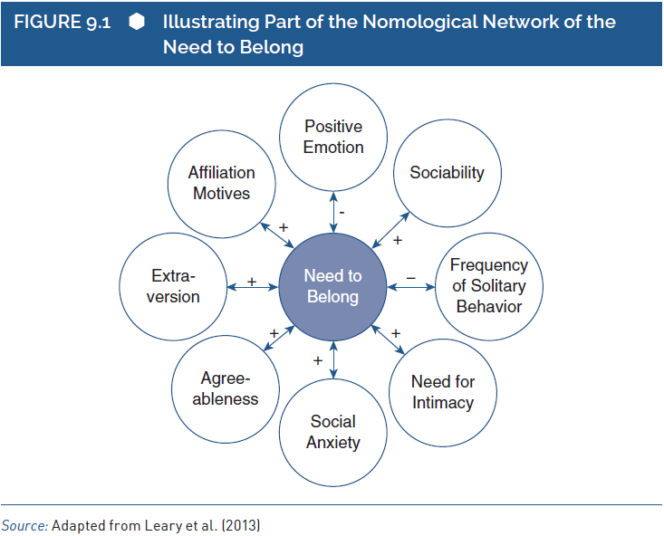
A Construct’s Nomological Network (2 of 2)
Notes:
Figure 9.1: Illustrating part of the nomological network of the need to belong (loosely based on Leary et al., 2013).
Source: Adapted from Leary et al. (2013).

Slide 5
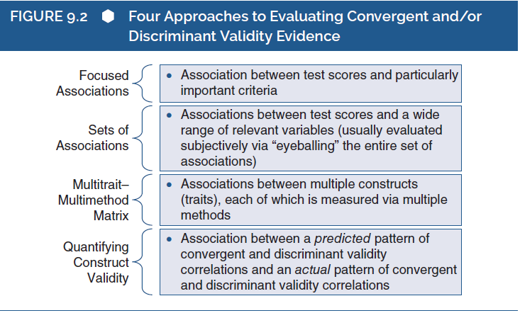
Methods for Evaluating Convergent and Discriminant Validity (1 of 13)
Notes:
Figure 9.2: Four approaches to evaluating convergent and/or discriminant validity evidence.

Slide 6
Methods for Evaluating Convergent and Discriminant Validity (2 of 13)
Focused Associations
Focus of evaluating validity.
Features of SAT.
Validity coefficients: establish validity.
Validity generalization: evaluate a test’s validity coefficients.
Notes:
Focus of evaluating validity:
Evaluating the validity of interpretations for such measures can focus on the associations between test scores and those particularly important criterion variables.
Research verifying those crucial predicted associations provides strong validity evidence, but research failing to verify the associations casts serious doubts on validity.
Features of SAT:
The SAT is intended to reflect the content knowledge and cognitive processes that students need to be ready for admission and be successful in college.
There are two kinds of variables that might be particularly critical for evaluating the SAT.
First, SAT scores should be associated with other measures of those types of knowledge and processes.
Second, because they are intended to assess constructs required for success in college, SAT scores should be associated with measures of collegiate academic performance.
In establishing the psychometric quality of the SAT, the college board appears to be most concerned with the latter issue.
Several documents that are made available to students, educators, and prospective researchers emphasize the correlation between SAT scores and academic indicators such as grades of first year.
The college board clearly focuses its validity argument heavily on the correlations between the SAT and a very specific set of criterion variables related to academic performance in college.
Validity coefficients:
One method for evaluating the validity of test interpretations is to focus on a few highly relevant criterion variables.
To the degree that test scores are indeed correlated with those crucial variables, test developers and test users gain increased confidence in the test.
Those correlations, sometimes called validity coefficients, are fundamental for establishing validity.
If research reveals that a test’s validity coefficients are generally large, then test developers, users, and evaluators have increased confidence in the quality of the test as a measure of its intended construct.
Validity generalization:
It is a process of evaluating a test’s validity coefficients across a large set of studies.
Validity generalization studies are intended to evaluate the predictive utility of a test’s scores across a range of settings, times, situations, and so on.
This study is a form of meta-analysis; it combines the results of several smaller individual studies into one large analysis.
A validity generalization study evaluates the degree to which the association between a test and an important criterion variable generalizes across individual studies that cover a range of populations, settings, and so on.

Slide 7
Methods for Evaluating Convergent and Discriminant Validity (3 of 13)
Focused Associations
Significance of single validity study.
NEO-PI-R conscientiousness scale.
Three important issues of validity generalization study.
Reasons for results of studies to differ.
Notes:
Significance of single validity study:
Mostly a researcher conducting a single validity study will recruit a sample of 50–400 participants, administer the measure of interest to those participants, assess additional criterion variables deemed relevant, and compute the correlation between the scores on the measure of interest and scores on the criterion measures.
Such studies are the basis of many measures used for research in personality psychology, clinical psychology, developmental psychology, social psychology, organizational psychology, and educational psychology.
All these studies include relatively small samples due to limits on researchers’ time, funding, and other resources.
The only drawback of this study is that study conducted at one location with one type of sample might produce results that do not generalize to another location or another type of sample.
NEO-PI-R conscientiousness scale:
The results of a study of bank employees might demonstrate that scores on the Revised NEO Personality Inventory (NEO-PI-R) conscientiousness scale are relatively good predictors of job performance for bank tellers.
If the trait of conscientiousness is more relevant for some kinds of jobs than for others, then one should not assume that it is a valid predictor of job performance in all professions.
Three important issues of validity generalization study:
First, they can reveal the general level of predictive validity across all of the smaller individual studies.
Second, validity generalization studies can reveal the degree of variability among the smaller individual studies.
The third issue that can be addressed by validity generalization studies is the source of variability among studies.
Reasons for results of studies to differ:
One reason is that the studies are based on different methods.
The differences in the measurement of the criterion variable contribute to differences in the size of the validity coefficient.
This kind of methodological source of variability should be considered when evaluating the implications of the general level and variability of validity coefficients across studies.
Another reason that validity studies might produce different results is that they reflect psychologically meaningful substantive differences.
This substantive difference may provide insight into the fundamental links between conscientiousness and job performance, and it would certainly have implications for use and interpretation of the scale itself.

Slide 8
Methods for Evaluating Convergent and Discriminant Validity (4 of 13)
Sets of Correlations
Evaluation by researchers.
The Perfectionism Inventory: measures eight facets of perfectionism.
Researchers making sense of the pattern of correlations.
Notes:
Evaluation by researchers:
A construct’s nomological network sometimes touches on a wide variety of other constructs with differing levels of association to the main construct.
In such cases, researchers often compute the correlations between the test of interest and measures of the many criterion variables.
The researchers evaluating convergent and discriminant validity evidence must also examine a wide range of criterion variables.
The perfectionism inventory:
Hill and other researchers developed a new measure of perfectionism, and they presented evidence of its convergent and discriminant validity.
The perfectionism inventory (PI) was designed to measure eight facets of perfectionism, so it was intended to have a multidimensional structure.
The PI was designed specifically to assess facets such as concern over mistakes, organization, planfulness, striving for excellence, and need for approval.
To evaluate the convergent and discriminant validity evidence, participants were asked to complete the PI along with measures of 23 criterion variables.
Criterion variables included other measures of perfectionism as well as measures of several symptoms of psychological distress.
Another point noted was that three of the PI scales, (1) Rumination, (2) Concern Over Mistakes, and (3) Need for Approval were strongly associated with fear of negative evaluation and with the frequency and severity of symptoms of obsessive–compulsive disorder.
Researchers making sense of the pattern of correlations:
Researchers gather a large amount of data concerning the test of interest and measures from a variety of other tests.
Then they examine the pattern of correlations, and they judge the degree to which the pattern generally “makes sense” given the conceptual meaning of the construct being assessed by the test.

Slide 9
Methods for Evaluating Convergent and Discriminant Validity (5 of 13)
Multitrait–Multimethod Matrices
Study papers submitted by researchers.
Purpose of MTMMM analysis.
Measures sharing trait variance.
Correlation produced by shared method variance.
Notes:
Study papers submitted by researchers:
In the year 1955, Cronbach and Meehl outlined a conceptual meaning of construct validity based on the notion of a nomological network.
It was not presented in a way to evaluate construct validity in a rigorous statistical manner.
In 1959, Campbell and Fiske built on the concept of construct validity as articulated by Cronbach and Meehl.
They developed the logic of a multitrait–multimethod matrix (MTMMM) as a statistical and methodological expansion of the conceptual work done by Cronbach and Meehl.
Purpose of MTMMM analysis:
To set clear guidelines for evaluating convergent and discriminant validity evidence.
This is served partially through evaluating two importantly different sources of variance that might affect the correlations between two measures: trait variance and method variance.
The MTMMM approach was designed to articulate these complexities, to organize the relevant information, and to guide researchers through the interpretations.
It provides useful guidelines for evaluating construct validity.
Measures sharing trait variance:
In terms of psychological phenomena, the finding might indicate that the trait of social skill shares something in common with the trait of emotional stability.
This means the measures might share trait variance.
For example, the people who are socially skilled might tend to become emotionally stable due to their social skill that allows them to create social relationships that have emotional benefits.
Correlation produced by shared method variance:
Despite our inclination to make a psychological interpretation of the correlation between social skill and emotional stability, the result might actually have a relatively nonpsychological basis.
So the correlation might be produced simply by shared method variance.
The correlation might be positive as it is based on two measures derived from the same source that is respondents’ self-reports in this case.
When measures are based on the same data source, they might share properties apart from the main constructs being assessed by the measures.

Slide 10
Methods for Evaluating Convergent and Discriminant Validity (6 of 13)
Multitrait–Multimethod Matrices
FIGURE 9.3 The 12 Measurements Gathered for Each Participant
in a Four-Trait/Three-Method MTMM Study
 |  | METHOD
 |  | Self-Report | Acquaintance Ratings | Interviewer Rating
TRAIT | Social Skill Impulsivity Conscientiousness Emotional Stability | 1 4 7 10 | 2 5 8 11 | 3 6 9 12
Notes:
Figure 9.3: The 12 measurements gathered for each participant in a four-trait/three-method MTMM study.

Slide 11
Methods for Evaluating Convergent and Discriminant Validity (7 of 13)
Multitrait–Multimethod Matrices
FIGURE 9.4 Trait Similarity/Differences and Method Similarity/
Differences as Explanations for Validity Correlations
 |  | POTENTIAL EXPLANATIONS
 |  | Trait Based | Method Based
RESULT | Strong Correlation | Same Trait (e.g., two measures of the same or similar traits) | Same Method (e.g., two measures based on the same method)
 | Weak Correlation | Different Trait (e.g., two measures of very different traits) | Different Method (e.g., two measures based on different methods)
Notes:
Figure 9.4: Trait similarity/differences and method similarity/differences as explanations for validity correlations.

Slide 12
Methods for Evaluating Convergent and Discriminant Validity (8 of 13)
Multitrait–Multimethod Matrices
Inherent ambiguity in correlation between two measures.
Focus on two correlation factors.
Predicting first correlation to be stronger than the second.
Notes:
Inherent ambiguity in correlation between two measures:
Due to the potential influences of trait variance and method variance, a correlation between two measures is a somewhat ambiguous finding.
On one hand, a strong correlation could indicate that the two measures share trait variance that is the psychological constructs that they are intended to measure truly do have some commonality.
On the other hand, a strong correlation either positive or negative could indicate that the two measures share method variance that is the measures are correlated mainly because they are based on the same method of measurement.
The ambiguity inherent in a correlation between two measures cuts both ways; it also complicates the interpretation of a weak correlation.
These ambiguities can create confusion when evaluating construct validity.
Focus on two correlation factors:
First is the correlation between the self-report measure of social skill and the acquaintance-report measure of social skill.
Second is the correlation between the self-report measure of social skill and the self-report measure of emotional stability.
Predicting first correlation to be stronger than the second:
Based on a consideration of the constructs being measured, the researchers might predict that the first correlation will be stronger than the second.
They might expect the first correlation to be quite strong as it is based on measures of the same construct and expect the second correlation to be relatively weak as social skill and emotional stability are different constructs.
But, based on a consideration of method variance, the researchers might expect to find that the first correlation is weaker than the second.

Slide 13
Methods for Evaluating Convergent and Discriminant Validity (9 of 13)
Multitrait–Multimethod Matrices
Four types of correlations derived from an MTMMM.
Correlation of self-report measure of social skill with other measures.
Limited usage of MTMMM approach.
Notes:
Four types of correlations derived from an MTMMM:
Heterotrait–heteromethod correlations: Based on measures of different constructs measured through different methods (e.g., a self-report measure of social skill correlated with an acquaintance-report measure of emotional stability).
Heterotrait–monomethod correlations: Based on measures of different constructs measured through the same method (e.g., a self-report measure of social skill correlated with a self-report measure of emotional stability).
Monotrait–heteromethod correlations: Based on measures of the same construct measured through different methods (e.g., a self-report measure of social skill correlated with an acquaintance-report measure of social skill).
Monotrait–monomethod correlations: Based on measures of the same construct measured through the same method (e.g., a self-report measure of social skill correlated with itself).
Correlation of self-report measure of social skill with other measures:
To provide strong evidence of its convergent and discriminant validity, the self-report measure of social skill should be more highly correlated with other measures of social skill than with any other measures.
The self-reported social skill is correlated with self-reports of a different trait to about the same degree that it is correlated with other ways of measuring the same trait.
Limited usage of MTMMM approach:
Despite the strong logic and widespread awareness of the approach, the MTMMM approach to evaluating convergent and discriminant validity evidence does not seem to be used very frequently.
In the 2016 volume of Psychological Assessment, a journal published by APA, there were only 13 articles claiming to present evidence related to convergent and discriminant validity or construct validity more generally.
Of these 13 articles, only 2 mentioned an MTMMM approach.
In that, one of the two articles treated positively keyed versus negatively keyed items as the “multimethod” component of the analysis, with all assessments being based on self-reports.

Slide 14
Methods for Evaluating Convergent and Discriminant Validity (10 of 13)
Quantifying Construct Validity
Method for evaluating validity evidence.
Imprecise interpretation of correlation.
Two kinds of results obtained in a QCV analysis.
QCV procedure in three phases.
Notes:
Quantifying construct validity:
A recently developed method by Westen and Rosenthal for evaluating convergent and discriminant validity evidence.
The researchers use the QCV procedure to formally quantify the degree of “fit” between:
Their theoretical predictions for a set of convergent and discriminant correlations.
The set of correlations that are actually obtained.
QCV procedure was designed to provide a more precise and more objective quantitative estimate of the support provided by the overall pattern of evidence.
The QCV procedure allows researchers to go beyond a subjective visual inspection, and concretely quantify the fit.
Imprecise interpretation of correlation:
The “sets of correlations” approach section stated that researchers often “eyeball” the correlations and make a subjective judgment.
Problem arises when one researcher’s subjective judgment does not agree with another’s judgment.
In the same way in MTMMM correlations, it was stated that some correlations were “generally larger” or “noticeably lower” than others.
This shows that although the correlations themselves are precise estimates of association, the interpretation of the overall pattern of convergent and discriminant correlations often has been done in a somewhat imprecise and subjective manner.
Two kinds of results obtained in a QCV analysis:
First, researchers obtain two effect sizes representing the degree of fit between the actual pattern of correlations and the predicted pattern of correlations.
These effect sizes, called r_{alerting-CV} and r_{contrast-CV}, are correlations themselves, ranging between –1 and +1.
Large positive effect sizes provide evidence of convergent and discriminant validity.
The second kind of result obtained in a QCV analysis is a test of statistical significance.
This test indicates whether the degree of fit between actual and predicted correlations is likely to have occurred by chance.
Researchers conducting a validity study using the QCV procedure will hope to obtain large values for the two effect sizes, along with statistically significant results.
QCV procedure in three phases:
Researchers must generate clear predictions about the pattern of convergent and discriminant validity correlations expected to find.
In second phase, researchers collect data and compute the actual convergent and discriminant validity correlations.
In the final phase of QCV procedure, researchers quantify the degree to which the actual pattern of convergent and discriminant correlations fits the predicted pattern of correlations.

Slide 15
Methods for Evaluating Convergent and Discriminant Validity (11 of 13)
Quantifying Construct Validity
Effect sizes and a significance test.
Representation by QCV analysis.
Limitations of fit indices.
Features of QCV.
Notes:
Effect sizes and a significance test:
The two effect sizes reflect the amount of evidence of convergent and discriminant validity as a matter of degree.
The r_{alerting-CV} effect size is the correlation between the set of predicted correlations and the set of actual correlations.
A large value indicates that the correlations predicted by judges to be small were indeed the ones that were small.
A small value indicates that the correlations predicted by judges to be large were indeed the ones that were large.
Though its computation is more complex, the r_{contrast-CV} effect size is similar to the r_{alerting-CV} effect size in that large positive values indicate greater evidence of convergent and discriminant validity.
Specifically, the computation of r_{contrast-CV} adjusts for the inter correlations among the criterion variables and for the absolute level of correlations between the main test and the criterion variables.
Representation by QCV analysis:
If the predicted correlations are poor reflections of the nomological network surrounding a construct, then a good measure of the construct will produce actual correlations that do not match the predictions.
Similarly, a poor choice of criterion variables could result in low effect sizes.
So the criterion variables selected for a QCV analysis should represent a range of strong and weak associations, reflecting a clear pattern of convergent and discriminant evidence.
Limitations of fit indices:
One of the most important limitations of all fit indices is that they cannot address whether the choice of items, indicators, observers, and so forth was adequate to the task.
QCV procedure has also been criticized for resulting in “high correlations” in cases where there is little agreement between predictions and observations.
Features of QCV:
QCV procedures are “aids to understanding” and should be carefully scrutinized in the context of many conceptual, methodological, and statistical factors.
The QCV offers several advantages over some other strategies:
It forces researchers to consider carefully the pattern of convergent and discriminant associations that would make theoretical sense, on the basis of the construct in question.
Second, it forces researchers to make explicit predictions about the pattern of associations.
Third, it retains the focus on the measure of primary interest.
Fourth, it provides a single interpretable value reflecting the overall degree to which the pattern of predicted associations matches the pattern of associations that is obtained.
Lastly, it provides a test of statistical significance.

Slide 16
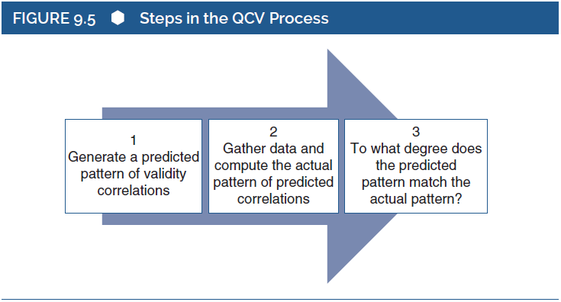
Methods for Evaluating Convergent and Discriminant Validity (12 of 13)
Quantifying Construct Validity
Notes:
Figure 9.5: Steps in the QCV process.

Slide 17
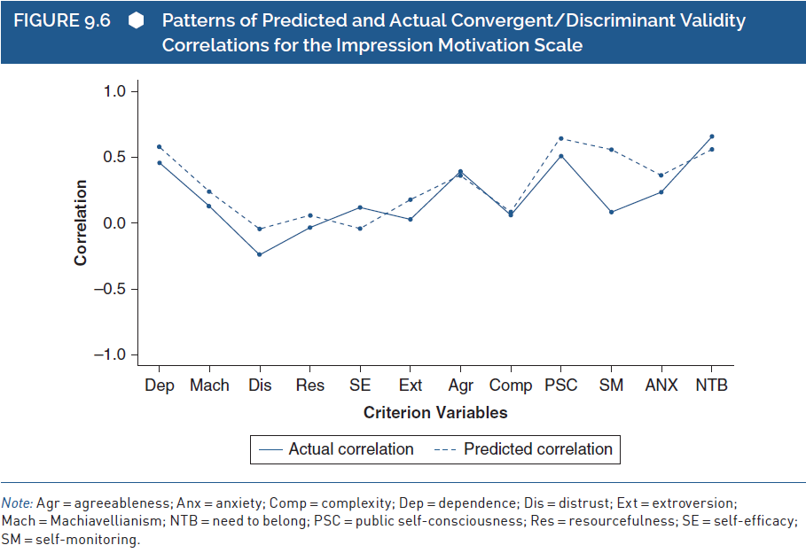
Methods for Evaluating Convergent and Discriminant Validity (13 of 13)
Quantifying Construct Validity
Notes:
Figure 9.6: Patterns of predicted and actual convergent/discriminant validity correlations for the Impression Motivation Scale.

Slide 18
Factors Affecting a Validity Coefficient (1 of 9)
Four strategies to evaluate convergent and discriminant validity.
Weak convergent associations that reflect flaws in a test.
Correlations between tests and criterion variables.
Notes:
Four strategies to evaluate convergent and discriminant validity:
The four strategies are used to accumulate and evaluate evidence of convergent and discriminant validity.
They rest on the size of validity coefficients, statistical results that represent the degree of association between a test of interest and one or more criterion variables.
When conducting or reading studies regarding validity, it is important to be aware of these factors.
It is also important to understand why a test’s scores might be strongly or, more problematic, weakly associated with key criterion variables for truly understanding of validity research.
Weak convergent associations that reflect flaws in a test:
There are many reasons why a test’s scores might not be strongly associated with key criterion variables.
Although weak convergent associations might reflect flaws in the test, such results might not actually reflect shortcomings.
By considering the various factors affecting these associations, people who produce and interpret validity studies will reach conclusions that are more well informed and accurate.
There is emphasis on correlation coefficient as an index of validity because of its interpretability as a standardized measure of association.
Correlations between tests and criterion variables:
Most values are built on correlation coefficients even if other statistical values can be used to represent associations between tests and criterion variables
Thus, main points are some of the key psychological, methodological, psychometric, and statistical factors affecting correlations between tests and criterion variables.
All these factors generally influence all effect sizes that might be used to evaluate the links between tests and criteria.

Slide 19
Factors Affecting a Validity Coefficient (2 of 9)
Associations between Constructs
Factor affecting correlation.
Findings of general and validity research.
Notes:
Factor affecting correlation:
One factor affecting the correlation between measures of two constructs is the “true” association between those constructs.
When two constructs are strongly associated with each other, then measures of those constructs will likely be highly correlated with each other.
On the contrary, if two constructs are unrelated to each other, then measures of those constructs will probably be weakly correlated with each other.
Findings of general and validity research:
When conducting general research, we intend to interpret the observed associations that we obtain as approximations of the true associations between the constructs in which we are interested.
When we conduct validity research, we predict that two measures will be correlated because we believe that the two constructs are associated with each other.

Slide 20
Factors Affecting a Validity Coefficient (3 of 9)
Random Measurement Error and Reliability
Implication of random measurement error.
Factors affecting validity coefficient.
Evaluating validity correlation.
Guidelines for identifying problematic levels of reliability.
Notes:
Implication of random measurement error:
An important implication of random measurement error is its effect on correlations between tests, it reduces, or attenuates, the correlation between tests.
Therefore, random measurement error affects validity coefficients, just like any other correlation.
The correlation between tests (say X and Y) of two constructs is a function of the true correlation between the two constructs and the reliabilities of the two tests.
Factors affecting validity coefficient:
First is the reliability of the test of interest and second is the reliability of the criterion test.
Thus, the primary test of interest could be a good measure of the intended construct, but the validity coefficient could appear to be poor.
Evaluating validity correlation:
While evaluating a validity correlation, one should consider both the reliability of the focal test and the reliability of the criterion test.
Even if any one or both is relatively weak, then the resulting validity correlation will appear relatively weak.
This might be subtle consideration for the criterion variable.
When the criterion measures that we use are poor, then we are unlikely to find evidence supporting the validity of the primary test.
Guidelines for identifying problematic levels of reliability:
When score of test’s reliability is above .70 or .80, then researchers are happy.
If a test’s or a criterion variable’s reliability is much lower than this, then we would have concerns about its effect on validity coefficients.
There are two possibilities for handling problems:
One is to simply discount a validity coefficient that is based on poor reliability, or at least to reduce the weight that you give it when considering validity evidence.
Second is to use the logic of the correction for attenuation.

Slide 21
Factors Affecting a Validity Coefficient (4 of 9)
Restricted Range
Correlation coefficient: covariability of two distributions of scores.
Association of SAT scores and academic performance.
Notes:
Correlation coefficient:
It reflects covariability between two distributions of scores.
It represents the degree to which variability in one distribution of scores corresponds with variability in another distribution of scores.
It is important to realize from this point that the amount of variability in one or both distributions of scores can affect the correlation between the two sets of scores.
Specifically, a correlation between two variables can be reduced if the range of scores in one or both variables is artificially limited or restricted.
Association of SAT scores and academic performance:
The quality of the SAT scores rests on the correlation between SAT scores and academic performance as measured by college grade point average (GPA).
College may valuate the validity of the SAT as a predictor of GPA among its students.
Those who score relatively high on the SAT tend to have relatively good performance at the college and who relatively score low have relatively bad performance.
The ability to demonstrate this association is minimized by restricted range in two ways:
First, range restriction exists in GPA as a measure of academic performance.
A second way in which range restriction minimizes the ability to demonstrate the association between SAT scores and academic performance is in the number of people who actually obtain college GPAs.
The students with very low SAT scores are less likely to be admitted to college than are students with higher SAT scores.
There are no easy tricks to detect range restriction, but there are procedures for adjusting or correcting correlations to account for range restriction.

Slide 22
Factors Affecting a Validity Coefficient (5 of 9)
Restricted Range
Three values needed to compute the corrected correlation.
Points to be considered in validity study.
Notes:
Three values needed to compute the corrected correlation:
The first is the correlation they actually obtained (r_{restricted}), which in their study was r_{restricted}= .474.
This is the correlation based on “restricted” SAT scores, and this is what they’d like to correct for range restriction in the SAT scores.
The second value is simply the standard deviation of the “restricted” SAT scores in their sample (s_{restricted}).
The third value is the “unrestricted” standard deviation of SAT scores—the standard deviation that would be obtained across a fuller range of SAT scores (s_{unrestricted}).
Using these three statistical values, the college can compute a correlation that corrects for range restriction: $r_{unrestricted}=\frac{r_{restricted}\left(\frac{s_{unrestricted}}{s_{restricted}}\right)}{\sqrt{1+r_{restricted}^{2}\left(\frac{s_{unrestricted}^{2}−1}{s_{restricted}^{2}}\right)}}$.
Points to be considered in validity study:
While evaluating the quality of a psychological measure, we often depend on correlations to reflect the degree of convergent and discriminant validity.
We need to be aware that restricted range can reduce the correlations that are actually obtained in a validity study.
The test users and test developers should be aware of the way that range restriction can affect validity correlations, and they might choose to “correct” validity correlations for these effects.

Slide 23
Factors Affecting a Validity Coefficient (6 of 9)
Skew and Relative Proportions
Effect of skew on the size of validity coefficient.
Terms affected by proportion of observations.
Study of positive and strong correlation.
Notes:
Effect of skew on the size of validity coefficient:
Another factor that affects the size of a validity coefficient is the “skew” of the distributions of scores being examined.
If the two variables being correlated have different “skews,” then the correlation between those variables will be reduced.
If validation study is conducted on a variable that is heavily skewed, then we might get a relatively small validity coefficient.
A subtle factor that might affect some validity coefficients is the skew of the variables being examine.
Terms affected by proportion of observations:
The correlation between two variables is the covariance between the two variables divided by the product of their two standard deviations.
Two terms continuous variable and dichotomous variable are directly affected by the proportion of observation in the groups.
The standard deviation of the dichotomous variable is the second term affected by the proportion of observations in the two groups defined by the dichotomous variable.
Study of positive and strong correlation:
When correlation is positive and fairly strong, it indicates good convergence between our new scale and clinicians’ diagnoses.
It reveals that those participants who had relatively “high scores” on the diagnosis variable also tended to have higher scores on the depression inventory than did those participants who had relatively “low scores” on the diagnosis variable.
Interpretation can be done as participants diagnosed as depressed who have high scores on the diagnosis variable tended to obtain high scores on the depression inventory as compared with the participants diagnosed as nondepressed who have low scores on the diagnosis variable.

Slide 24
Factors Affecting a Validity Coefficient (7 of 9)
Method Variance
Consideration beyond its role in MTMMM.
Implication for validity coefficients.
Evaluating a new self-report measure of social skill.
Validity studies and interpreting correlation.
Notes:
Method variance:
An important consideration beyond its role in an MTMMM analysis.
Whenever a researcher correlates test scores with scores from a different method of assessment, method variance is likely to reduce the correlation.
Implication for validity coefficients: When researchers are evaluating validity coefficients, they are more impressed by correlations between different methods of assessment than by correlations based on a single method of assessment.
Evaluating a new self-report measure of social skill:
As part of our validation work, we might correlate scores on the new measure with scores on self-report measures of charisma, on the assumption that social skill is associated with charisma.
It is good to find a correlation of .40 between the two measures, and we might interpret these results as evidence of convergent validity.
We might be more happy if we had found a correlation of .40 between our self-report measure of social skill and an acquaintance-report measure of charisma.
When two variables are measured through different methods of assessment, they tend to be less strongly correlated with each other than when two variables are measured through the same method.
Validity studies and interpreting correlation:
Validity studies based solely on self-report are informative and common, but they are not perfect.
The self-report data are very easy, inexpensive, and generally quite good, so we do not intend to imply that self-report data are inferior to data derived from other forms of measurement.
But correlations based solely on self-report questionnaires are potentially inflated due to shared method variance.
Contrastingly, correlations that are based on data from two different assessment methods are less likely to be artificially inflated.
These correlations provide an important complement to the more common reliance on self-report data.
It is important to realize while interpreting correlations based on different methods that they are likely to be smaller than correlations based solely on self-report data as a result of method variance.

Slide 25
Factors Affecting a Validity Coefficient (8 of 9)
Time
Evaluating validity with respect to time.
Change in validity coefficients in relation to time.
Notes:
Evaluating validity with respect to time: Validity is sometimes evaluated by examining the correlation between a test given at one point in time and a criterion variable measured at a later point in time.
Change in validity coefficients in relation to time:
All others being equal, validity coefficients based on correlations between variables measured at different points in time are likely to be smaller than coefficients based on correlations between variables measured at a single point in time.
It is also likely that longer periods between two points in time will produce smaller predictive validity correlations.

Slide 26
Factors Affecting a Validity Coefficient (9 of 9)
Predictions of Single Events
Whether the criterion variable is based on single or aggregate event.
Significance of larger validity correlation.
Analysis by Abelson on baseball players.
Difficulty to predict in single events.
Notes:
Predictions of single events:
An important factor that can affect validity coefficients is whether the criterion variable is based on an observation of a single event or on an aggregation or accumulation of events.
A questionnaire was developed to interpret as a measure of extroversion and convergent validity evidence is to be gathered by correlating its scores with observations of “talkativeness” in social interaction.
Your understanding of the extroversion construct suggests that extroverted people should be relatively talkative in a social interaction, so you expect to find a moderate-to-large positive correlation between scores on your questionnaire and observations of talkativeness.
Significance of larger validity correlation:
The validity correlation might have been larger if you had gathered observations of your participants from several different interactions or over a longer period of time.
For various reasons, including issues of poorer reliability, single events are less predictable than are aggregations of events or accumulations of observation.
Analysis by Abelson on baseball players:
Some baseball players are paid tens of millions of dollars, partly because they have batting averages that are much higher than the average player.
The owners and managers of baseball teams believe that players with high batting averages will be much more successful than players with low batting averages.
But it is to be noted how much of this is true, and how much variability in at-bat success is actually explained by batting average?
His analysis revealed what he interpreted as a “pitifully small” association between batting skill and success in a single at bat.
He concludes by stating that “the individual batter’s success is appropriately measured over a long season, not by the individual at bat.”
Difficulty to predict in single events:
Whether baseball at bats or a specific social behavior in a specific social situation it is not easy to predict by taking into account single events.
In terms of validity coefficients, one must consider this issue in relation to the criterion variable.
Large validity coefficients may be likely when the criterion variable is based on the accumulation or aggregation of several events than when it is based on only a single event.

Slide 27
Interpreting a Validity Coefficient (1 of 9)
Obtaining validity coefficient.
Problematic tendency when evaluating validity coefficient.
Key factors affecting the size of a validity coefficient.
Notes:
Obtaining validity coefficient:
After obtaining a validity coefficient, it must be interpreted.
Test developers, evaluators, and users must decide whether validity coefficients are large enough to provide compelling evidence of convergence or if they are small enough to provide assurance of discriminant validity.
Problematic tendency when evaluating validity coefficient:
Even though it is a precise way of quantifying the degree of association between two measures, the correlation coefficient might not be highly intuitive.
This tendency could be problematic when evaluating a validity coefficient, particularly when discussing validity with someone who lacks experience with interpreting correlations.
This suggests that people who score relatively high on the test tend to exhibit relatively high job performance.
However, when correlations don’t match, employees, test takers, or lawyers might interpret this evidence quite differently.
This is when people believe that it is evidence of invalidity.
Key factors affecting the size of a validity coefficient:
Issues like the true correlation between constructs, method variance, relative proportions, and reliability are some key factors affecting the size of a validity coefficient.
Other additional important issues become relevant when interpreting the size and meaning of a validity coefficient.

Slide 28
Interpreting a Validity Coefficient (2 of 9)
Squared Correlations and “Variance Explained”
Correlation interpreted as proportion of variance.
Use of variance explained interpretation.
Three reasons of criticism.
Ways in which assertion about SAT is misguided.
Notes:
Squared correlation: Between two variables, it is often interpreted as the proportion of variance in one variable that is explained or “accounted for” by the other.
Use of variance explained interpretation:
The “variance explained” interpretation is appealing, given our earlier assertion that research in general is concerned with measuring and understanding variability.
More variability in phenomenon, more we feel to understand the same.
The “variance explained” interpretation fits well with various statistical procedures such as regression and analysis of variance (ANOVA), which rely on partitioning or predicting variability.
Three reasons of criticism:
First, it is technically incorrect in some cases.
In some cases, the correlation itself, and not the squared correlation, is interpretable as the proportion of variation explained.
Second, variance itself is based on a nonintuitive metric.
The squared correlation approach might be seen as a nonintuitive and, therefore, non useful perspective on the association between variables.
The third criticism of the squared correlation approach is the least technical but perhaps the most powerful of the three.
The squared correlation” or “variance explained” interpretation of validity coefficients is common but potentially confusing.
Though it fits the view of research and measurement as tied to variability, it has several technical and logical limitations.
Most critically, a “variance explained” approach tends to cast associations in a way that may confusingly minimize their size and importance.
Ways in which assertion about SAT is misguided: The assertion that the SAT is a poor predictor of college academic performance and is thus invalid and useless is misguided in the following two ways:
First, contrary to the assertion’s argument, there is no need to square a correlation in order to interpret it.
There are researchers from many areas of psychology and other sciences who report correlations regularly without squaring them.
The correlation itself is a meaningful and reasonable index of association.
It is futile to imply that a given value is deceptive or inappropriate but that squaring it makes it clear and interpretable.
Second, the suggestion that the ability to account for “only” 22% of the variance in freshman GPA is poor is itself off the mark.
Social and behavioral scientists would be quite happy if they could account for “only” 22% of the variance in an important and complex variable like freshman GPA.
For psychological scientists trained in the study of individual differences and predictive validity, these results provide compelling evidence in support of the SAT as a measure of capacity for academic achievement.

Slide 29
Interpreting a Validity Coefficient (3 of 9)
Estimating Practical Effects: Binomial Effect Size Display, Taylor–Russell Tables, Utility Analysis, and Sensitivity/Specificity
Useful way of interpreting correlation.
Framing the issue of SAT.
Illustrating the practical consequences of using a correlation.
Notes:
Useful ways of interpreting correlation:
By estimating its impact on “real-life” decision-making and predictions.
Larger a correlation is between a test and a criterion variable, the more successful we will be in using the test to make predictions or decisions about the criterion variable.
This approach casts the associative strength of a test in terms that are closely tied to the “practice” of testing and test use.
Framing the issue of SAT:
Issue can be framed in terms of using it as a tool to predict academic performance.
It can be done in a way that university administrators, faculty members, student applicants, high school counsellors, and parents are likely to find relatively intuitive.
Questions can be framed in terms of the percentage of times that SAT-based predictions about students’ college GPAs are likely to be accurate.
Illustrating the practical consequences of using a correlation:
The BESD is designed to illustrate the practical consequences of using a correlation to make decisions.
It is specifically formatted to make predictions or decisions for a group of 200 people—100 who have relatively high scores on the test of interest and 100 who have relatively low scores on the test.
Question like what proportion will perform well or poor are designed to be answered.
The BESD procedure can be used to show how many successful and unsuccessful predictions will be made on the basis of a correlation.

Slide 30
Interpreting a Validity Coefficient (4 of 9)
Estimating Practical Effects: Binomial Effect Size Display, Taylor–Russell Tables, Utility Analysis, and Sensitivity/Specificity
Examining tables by Taylor and Russel.
Utility analysis to interpret the meaning of a validity coefficient.
Evaluating practical effect of test.
Notes:
Examining tables by Taylor and Russel:
For situations in which the equal proportions assumption is untenable, we can examine the tables prepared by Taylor and Russell.
These tables were designed to inform selection decisions, and they provide the probability that a prediction based on an “acceptable” test score will result in successful performance on the criterion.
The Taylor–Russell tables cast the predictor and outcome scores as dichotomous variables.
The key difference between the BESD and the Taylor–Russell tables is that the Taylor–Russell tables can accommodate decisions that are based on various proportions both for passing/ failing on the test and for successful/unsuccessful performance.
The Taylor–Russell approach has been popular in industrial/organizational psychology in terms of hiring decisions.
Utility analysis to interpret the meaning of a validity coefficient:
Utility analysis is a third method of interpreting the meaning of a validity coefficient, and it can be seen as expanding on the logic of the BESD and the Taylor–Russell tables.
Utility analysis frames validity in terms of a cost-versus-benefit analysis of test use.
For this analysis, researchers assign monetary values to various aspects of the testing and decision-making process.
First of all, they must estimate the monetary benefit of using the test to make decisions, as opposed to alternative decision-making tools.
Secondly, researchers must estimate the monetary costs of implementing the testing procedure as part of the decision-making process, such as the costs incurred by purchasing and scoring the test, training decision makers in the interpretation and use of test scores, and the time spent by test takers and decision makers in using the test.
The outcome is researchers can evaluate whether the monetary benefits of test use outweigh the potential costs associated with test use. Interested readers can find additional details and examples in other sources.
Evaluating practical effect of test:
An analysis of test sensitivity and test specificity is a fourth approach to evaluating the practical effects of using a test.
This approach is particularly useful for tests that are designed to detect a categorical difference, where a test can be evaluated in terms of its ability to correctly identify the categorical difference.

Slide 31
Interpreting a Validity Coefficient (5 of 9)
Estimating Practical Effects: Binomial Effect Size Display, Taylor–Russell Tables, Utility Analysis, and Sensitivity/Specificity
Four possible outcomes of our test’s performance.
Sensitivity and specificity: summarize proportion of identifications.
Notes:
Four possible outcomes of our test’s performance:
True positive: The test leads us to a correct identification of a respondent who truly has the disorder, that is, the individual truly has BPD, and our test correctly indicates that BPD is indeed present.
True negative: The test leads us to a correct identification of a respondent who truly does not have the disorder, that is, the individual truly does not have BPD, and our test correctly indicates that BPD is indeed absent.
False positive: The test leads us to incorrectly identify a respondent as having the disorder, that is, the individual truly does not have BPD, but our test incorrectly indicates that BPD is present.
False negative: The test leads us to incorrectly identify a respondent as not having the disorder, that is, the individual truly does have BPD, but our test incorrectly indicates that BPD is absent.
Sensitivity and specificity:
They are the values that summarize the proportion of identifications that are correct in one way or another.
Sensitivity reflects the ability of a test to correctly identify individuals who truly have the disorder.
The sensitivity is the proportion of people with BPD who are correctly identified by test as having BPD.
High sensitivity is not sufficient for us to claim good validity for the test as a measure of BPD.
A test might achieve high sensitivity simply by identifying everyone as having the disorder.
Such a result would eliminate the utility of our test.

Slide 32
Interpreting a Validity Coefficient (6 of 9)
Guidelines or Norms for a Field
Area of research or application.
Discovery of associations by researchers in physical science.
Evaluating validity coefficient for new test.
Notes:
Area of research or application:
Different areas of science might have different norms for the size of the associations that are typically found.
Some areas have greater experimental control over their variables than other areas.
Some have more precise measurement techniques than others.
Some may have more complex phenomena, in terms of multi determination, than others.
These differences affect the magnitude of results obtained in research.
Discovery of associations by researchers in physical science:
Researchers in the physical sciences might commonly discover associations that most psychologists and other behavioral scientists would consider incredibly strong.
A group of astrophysicists examined the association between the mass of a black hole at the center of a galaxy and the average velocity of stars at the edge of that galaxy.
As per Cohen guidelines for the interpretation of correlations, correlations of .10 are considered small, correlations of .30 are considered medium, and correlations of .50 are considered as large.
Another researcher Hemphill conducted a review of several large studies and suggests that a more appropriate set of guidelines would cite correlations below .20 as small, correlations between .20 and .30 as medium, and correlations greater than .30 as large.
Funder and Ozer provided guidelines based upon a number of factor which included typical findings in the area of social/personality psychology and “in other relationships encountered in daily experience.”
Evaluating validity coefficient for new test:
The usefulness of such broad guidelines in general or for other areas of psychology or the behavioral sciences is an interesting question.
The broad generalized guidelines can fortunately be replaced by clear comparison standards for a particular validity coefficient.
Here, it is simple to evaluate the validity coefficient for a new test in the context of the existing body of highly relevant literature.
The interpretation of validity coefficients, as with any measure of association, needs to be done with regard to the particular field.
Utmost care and well-informed attention to the existing empirical work in a field can provide an important context for interpreting the magnitude of a specific validity coefficient.

Slide 33
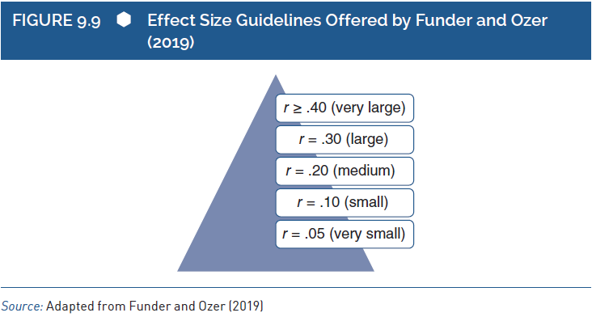
Interpreting a Validity Coefficient (7 of 9)
Guidelines or Norms for a Field
Notes:
Figure 9.9: Effect size guidelines offered by Funder and Ozer (2019).

Slide 34
Interpreting a Validity Coefficient (8 of 9)
Statistical Significance
Procedures to help make inferences about populations.
Using data from sample to make inferences about population.
Need to find statistical significance of validity coefficient.
Notes:
Statistical significance:
It is the final consideration we will discuss in evaluating evidence of convergent and discriminant quality.
Statistical significance is part of what is called inferential statistics, which are procedures designed to help researchers make inferences about populations.
It is an important issue while interpreting evidence for convergent and discriminant validity.
The fact that statistical significance is affected by sample size, effect size, and alpha level is an extremely important point.
Using data from sample to make inferences about population:
A small sample of participants provide the data that are analyzed and serve as the basis for interpretations and conclusions.
However, researchers usually want to make conclusions about people beyond those few who happened to participate in their study.
Because a study’s participants are assumed to represent a larger population, researchers also assume that those participants’ data represent the data that would be collected from the entire population.
Thus, researchers use the data from the sample to make inferences about the population that the sample represents.
Need to find statistical significance of validity coefficient:
The size of a validity coefficient is only part of the picture in evaluating the evidence for or against construct validity.
In addition to knowing and interpreting the validity coefficient itself, test developers, test users, and test evaluators usually want to know whether the validity coefficient is statistically significant.
When evaluating convergent validity evidence, researchers expect to find validity coefficients that are statistically significant and vice versa.
That means when evaluating discriminant validity evidence, researchers expect to find validity coefficients that are nonsignificant.

Slide 35
Interpreting a Validity Coefficient (9 of 9)
Statistical Significance
Importance in interpretive process.
Factors affecting statistical significance and confidence.
Nonsignificant convergent validity and significant discriminant validity.
Features of statistical significance.
Notes:
Importance in interpretive process:
Since statistical significance is often such an important part of the interpretive process, one should have a basic understanding of the issue being addressed and the factors affecting statistical significance.
The statistical significance process leads to a dichotomous decision, where researchers conclude either that there probably is an association between a test and a criterion in the population or that there might not be an association between the test and the criterion in the population.
Researchers when evaluating convergent validity would like to conclude that there is an association between a test and a criterion in the population, so they hope to find results that are statistically significant.
Researchers when evaluating discriminant validity would like to conclude that there is no association between a test and a criterion, so they hope to find results that are nonsignificant.
Factors affecting statistical significance and confidence:
First factor:
Larger correlations in the sample’s data increase our confidence that the population correlation is not 0.
Consequently, larger correlations in the sample data increase the likelihood that the correlation will be considered statistically significant.
Size of sample is the second factor affecting the amount of confidence that there is a nonzero correlation in the population.
In sum, the size of the correlation and the size of the sample affect our confidence in concluding that there is a nonzero correlation in the population.
Nonsignificant convergent validity and significant discriminant validity:
A nonsignificant convergent validity correlation could occur because the correlation is small or because the sample is small.
If the correlation is small, then this certainly could be evidence against the convergent validity of the test, however, if the correlation is moderate to large in size but the sample is small, then the results might not indicate poor convergent validity.
The other side of this is when significant discriminant validity correlation could occur because the correlation is large or because the sample is large.
If the correlation is large, then this could be considered evidence against the discriminant validity of the test.
However, if the correlation is small but the sample is quite large, then the results might not indicate poor discriminant validity.
Features of statistical significance:
Statistical significance is important but tricky concept as it is applied to validity evidence.
Although it often plays a role in the interpretation of convergent and discriminant validity coefficients, it should be treated with some caution.
Sophisticated understanding of statistical significance reveals that the size of the sample and the size of the convergent and discriminant validity correlations both determine significance.
Nonsignificant convergent correlation could reflect the fact that the study had an inadequate sample size, and a significant discriminant correlation could reflect the fact that the study had an extremely large sample size.

